Slide 1


Traffic Optimization Using Machine Learning
Making intersections smarter to reduce driver frustration
Joe Kessler – Principal Software Developer

Slide 2
Heavy Traffic Sucks
Very frustrating at times
Leads to road rage
Makes us late to the dog groomer
Ever get “all the red lights”? It really does matter
Travel time
Sense of victimhood
Harder on vehicles
Increases fuel consumption and therefore cost

Slide 3
Reasons for Annoying Traffic
Volume, obviously
Overly simple traffic control signals
Often sensor based with timer component
Sometimes only timers
Rubber banding
Getting “out of sync” with lights causes stop-and-go

Slide 4
What Can We Do to Help?
Make intersections smarter
Control traffic more like a person would
Incorporate “common sense”
Concepts
Avoid unnecessary red lights
Retain traffic momentum where possible
Reduce rubber banding

Slide 5
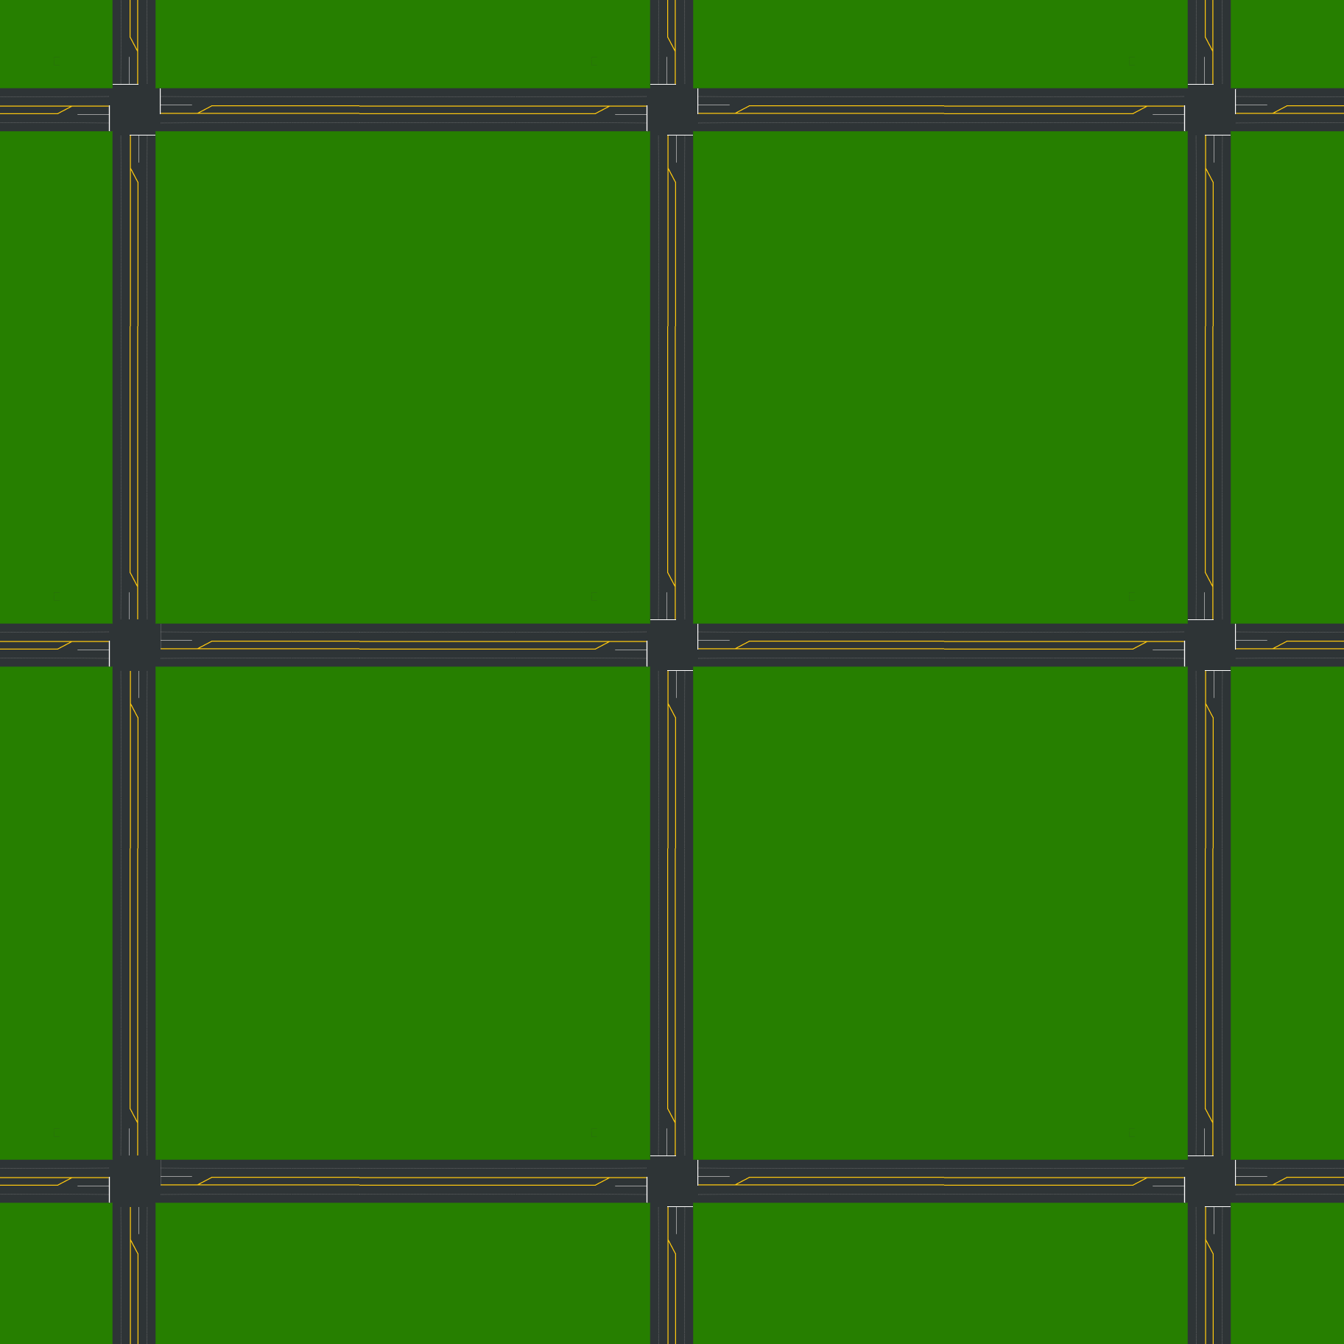
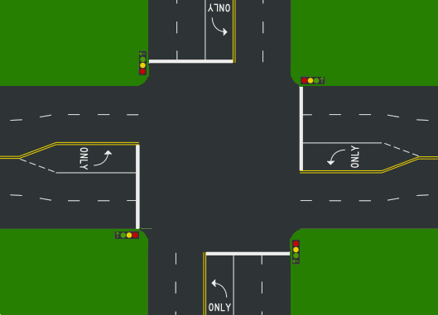
Simulated Neighborhood
Simple “city” grid interconnected by lights
Each agent/component with independent logic
Intersections (Stock)
Intersections (Enhanced/ML)
Cars
Left turn lanes
Sensors
Cameras
Etc…

Slide 6
Simulation Characteristics
The environment simulates
Intersection logic
Typical car/driver behavior and reactions
Traffic volume at a variety of times,
Sensors at each stop line, including distinct left lane sensors
Speed limits
Etc…
Virtual cameras to provide images of oncoming traffic

Slide 7
Driver Behavior
Self-contained agents (disconnected from intersection logic, etc)
All follow same rules - there is no road rage!
Have a “GPS” telling them the route at start of travel
That is, travel directions are not fixed
Can turn left or right at intersections
Max speed is 40 MPH for entire town but doesn’t have to be

Slide 8
Technical Pieces
Simulator (Python)
CNN/ML model training (Python/Keras/TensorFlow)
Training Data Generator (C#/WinForms)
Traffic Visualizer (C#/WinForms)
Traffic Camera WS (C#/ASP.NET)
Runtime hardware
12th Gen Intel Core i7-12700K
128GB DDR4-3600
Nvidia RTX 3090ti (24GB onboard)

Slide 9
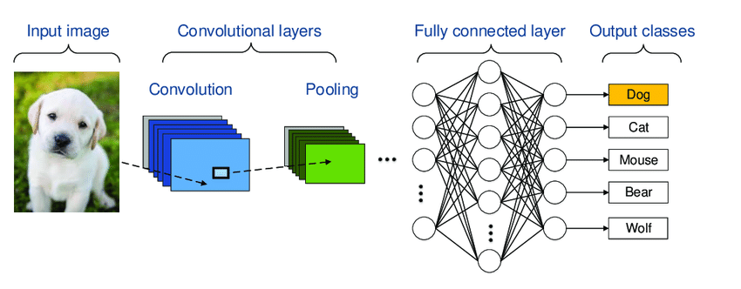
CNN Construction
CNN learns how to translate an image into usable output
Can classify (dog, cat, etc) or regress (produce values)
In our case, we want to count/locate cars

Slide 10
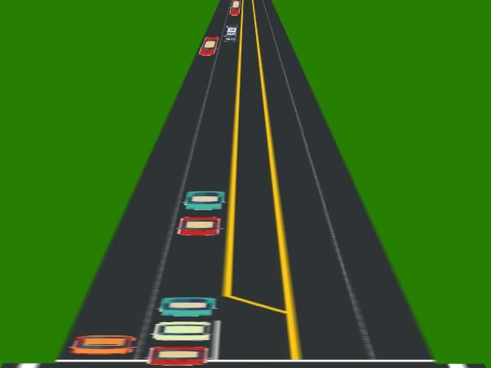
What Does CNN Buy Us?
(Sample CameraWS image)
The CNN can process this image and understand
How many cars
Rough idea of distances
Like having sensors on the entire road segment
Combined with stop line sensors
We get a decent idea of situation
From there all that is required is some simple logic

Slide 11
Generating Data via Random Sampling
Training a neural network requires lots of data
Generate annotated sample for a neural net
Create image from random traffic data (interpretation -> image)
Annotate automatically
Neural net learns to perform inverse (image -> interpretation)

Slide 12
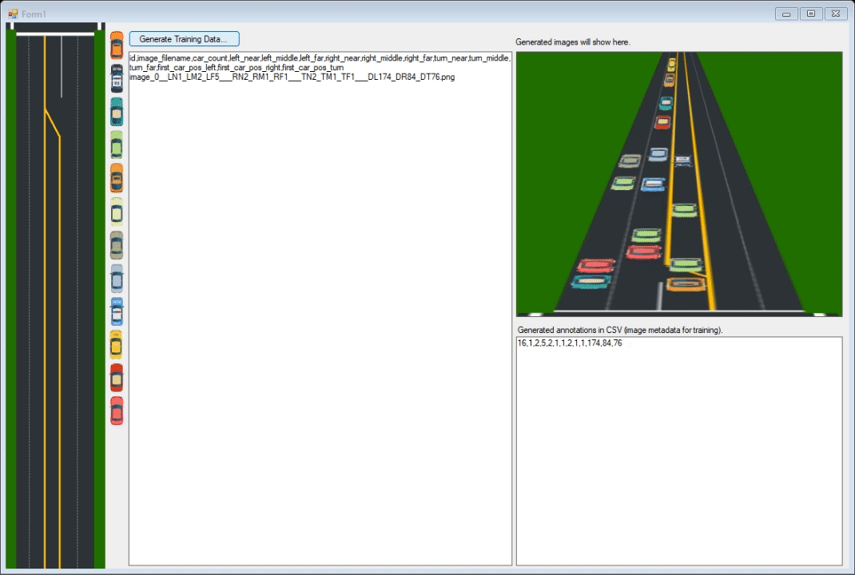
CNN Training Data Generator
Generates and annotates sample traffic images
For training CNN to understand camera frame captures

Slide 13
Distance Zones
The CNN can see rough distance of cars via “zones”
A single frame is processed by the CNN and assigned to these zones
Zones exist for each of three lanes (therefore 9 regions)
CNN understands perspective
Actual intersection logic is extremely simple
Far
Middle
Near

Slide 14
CNN Model in Keras (Python) Training on Roughly 20,000 Sample Images
# Load up the training data.
data, labels = myutils.load_training_data(outputPath)
# Partition the data into training and testing splits using 75% of
# the data for training and the remaining 25% for testing
(trainX, testX, trainY, testY) = train_test_split(data, labels, test_size=0.25, random_state=42)
# Set up the CNN model. Sometimes layers/settings are trial and error.
model = Sequential()
model.add(Conv2D(32, kernel_size=(5, 5), strides=(1, 1), activation='relu', input_shape=imageShape))
model.add(MaxPooling2D(pool_size=(2, 2), strides=(2, 2)))
model.add(Conv2D(32, (5, 5), activation='relu'))
model.add(MaxPooling2D(pool_size=(2, 2)))
model.add(Flatten())
model.add(Dense(100, activation='relu'))
model.add(Dense(100, activation='relu'))
model.add(Dense(9, activation='sigmoid’)) # Trains on 9 “zones” on 3 lanes.
# Train the model. Yoiks!
model.compile(optimizer='rmsprop', loss='mean_squared_error', metrics=['accuracy'])
model.fit(trainX, trainY, batch_size=1, epochs=250, verbose=1)

Slide 15
Applying the CNN in Simulator Pretty easy once we have all the pieces!
# This code is going images in each direction from the perspective of the # intersection. It will then use the CNN model to decode it into usable data.
model_cnn = model_functions.load_camera_model(self.global_ctx, False)
# Capture the images in each oncoming direction via CameraWS. This accesses
# four cameras mounted at the intersection.
predictions_by_oncoming_direction = { 'north': None, 'south': None, 'east': None, 'west': None };
images_by_oncoming_direction = capture_image(myconstants.camera_ws_url)
# Convert each image to usable values.
for oncoming_direction in images_by_oncoming_direction:
image_for_this_direction = images_by_oncoming_direction[oncoming_direction]
# Prediction (camera image -> data) from the trained CNN model.
predicted_data_from_image = model_cnn.predict(direction, verbose = 0)
# Wrap it up nicely.
traffic_scenario = TrafficScenario(self, predicted_frustration_level, road_lanes, self.global_ctx)
predictions_by_oncoming_direction[orientation] = traffic_scenario
return predictions_by_oncoming_direction

Slide 16
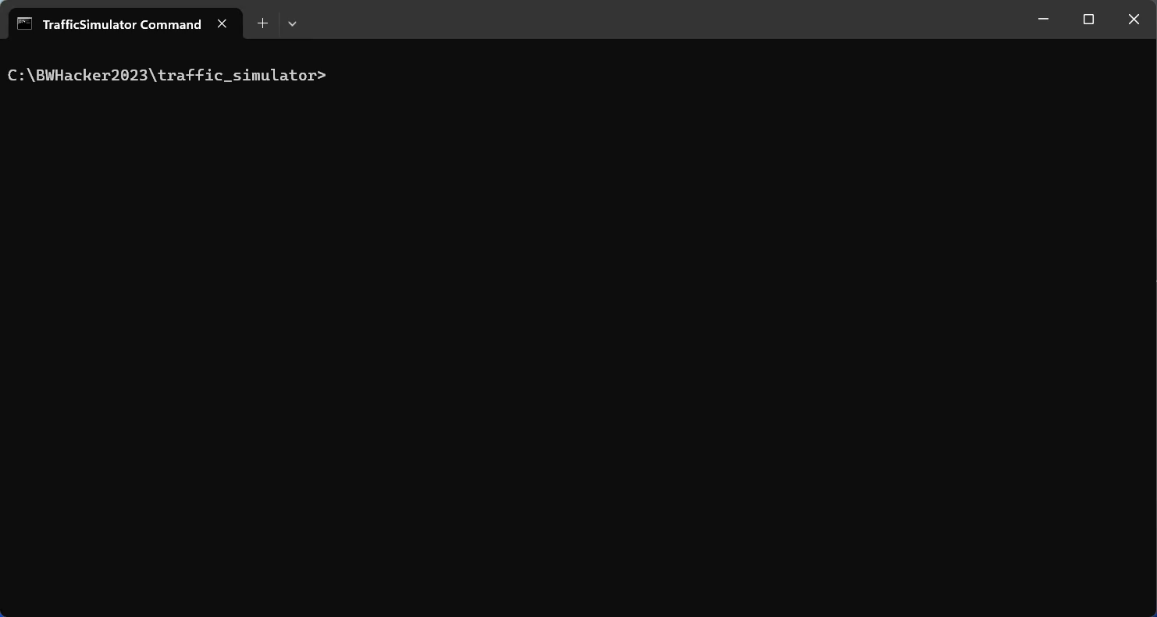
Running the Simulator (Python Code)

Slide 17
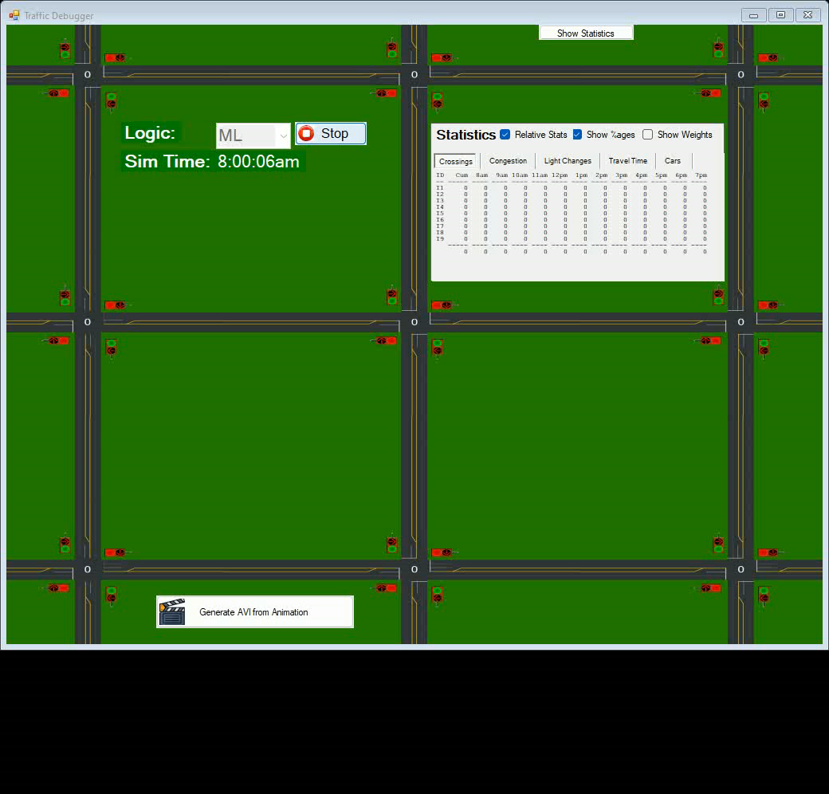
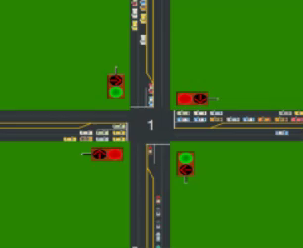

(Zoomed)

Slide 18
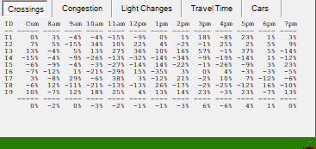
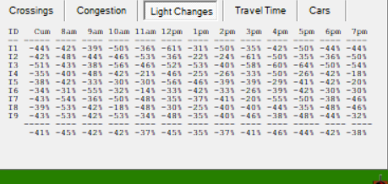
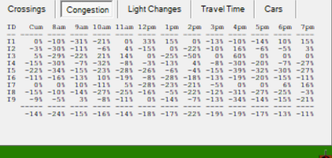
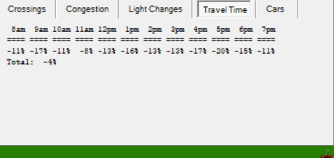
Results – Delta % from Stock

Slide 19
Results - Interpretation
Same throughput since cars on the road are same (0% diff)
Fewer signal changes (by almost 50%!)
Drivers more likely to maintain momentum as the ML changes states at better times
Lower congestion (-14% overall)
Lower travel times (-11% overall)

Slide 20
General Comments
This was very challenging!
Can it be applied in “real” areas like network routing?

Slide 21
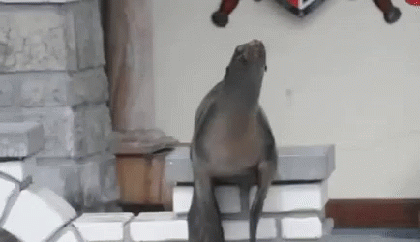
Clap Clap Clap!
Any Questions?
Too bad, this is a pre-recorded video!!!
Seriously, send any questions/comments to Joe Kessler (me)
There is no complaint box, alas!

